Slide 1
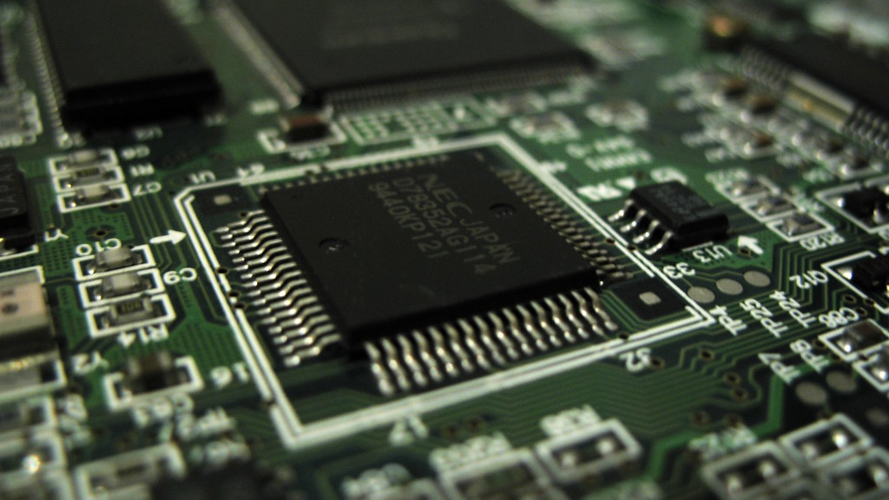
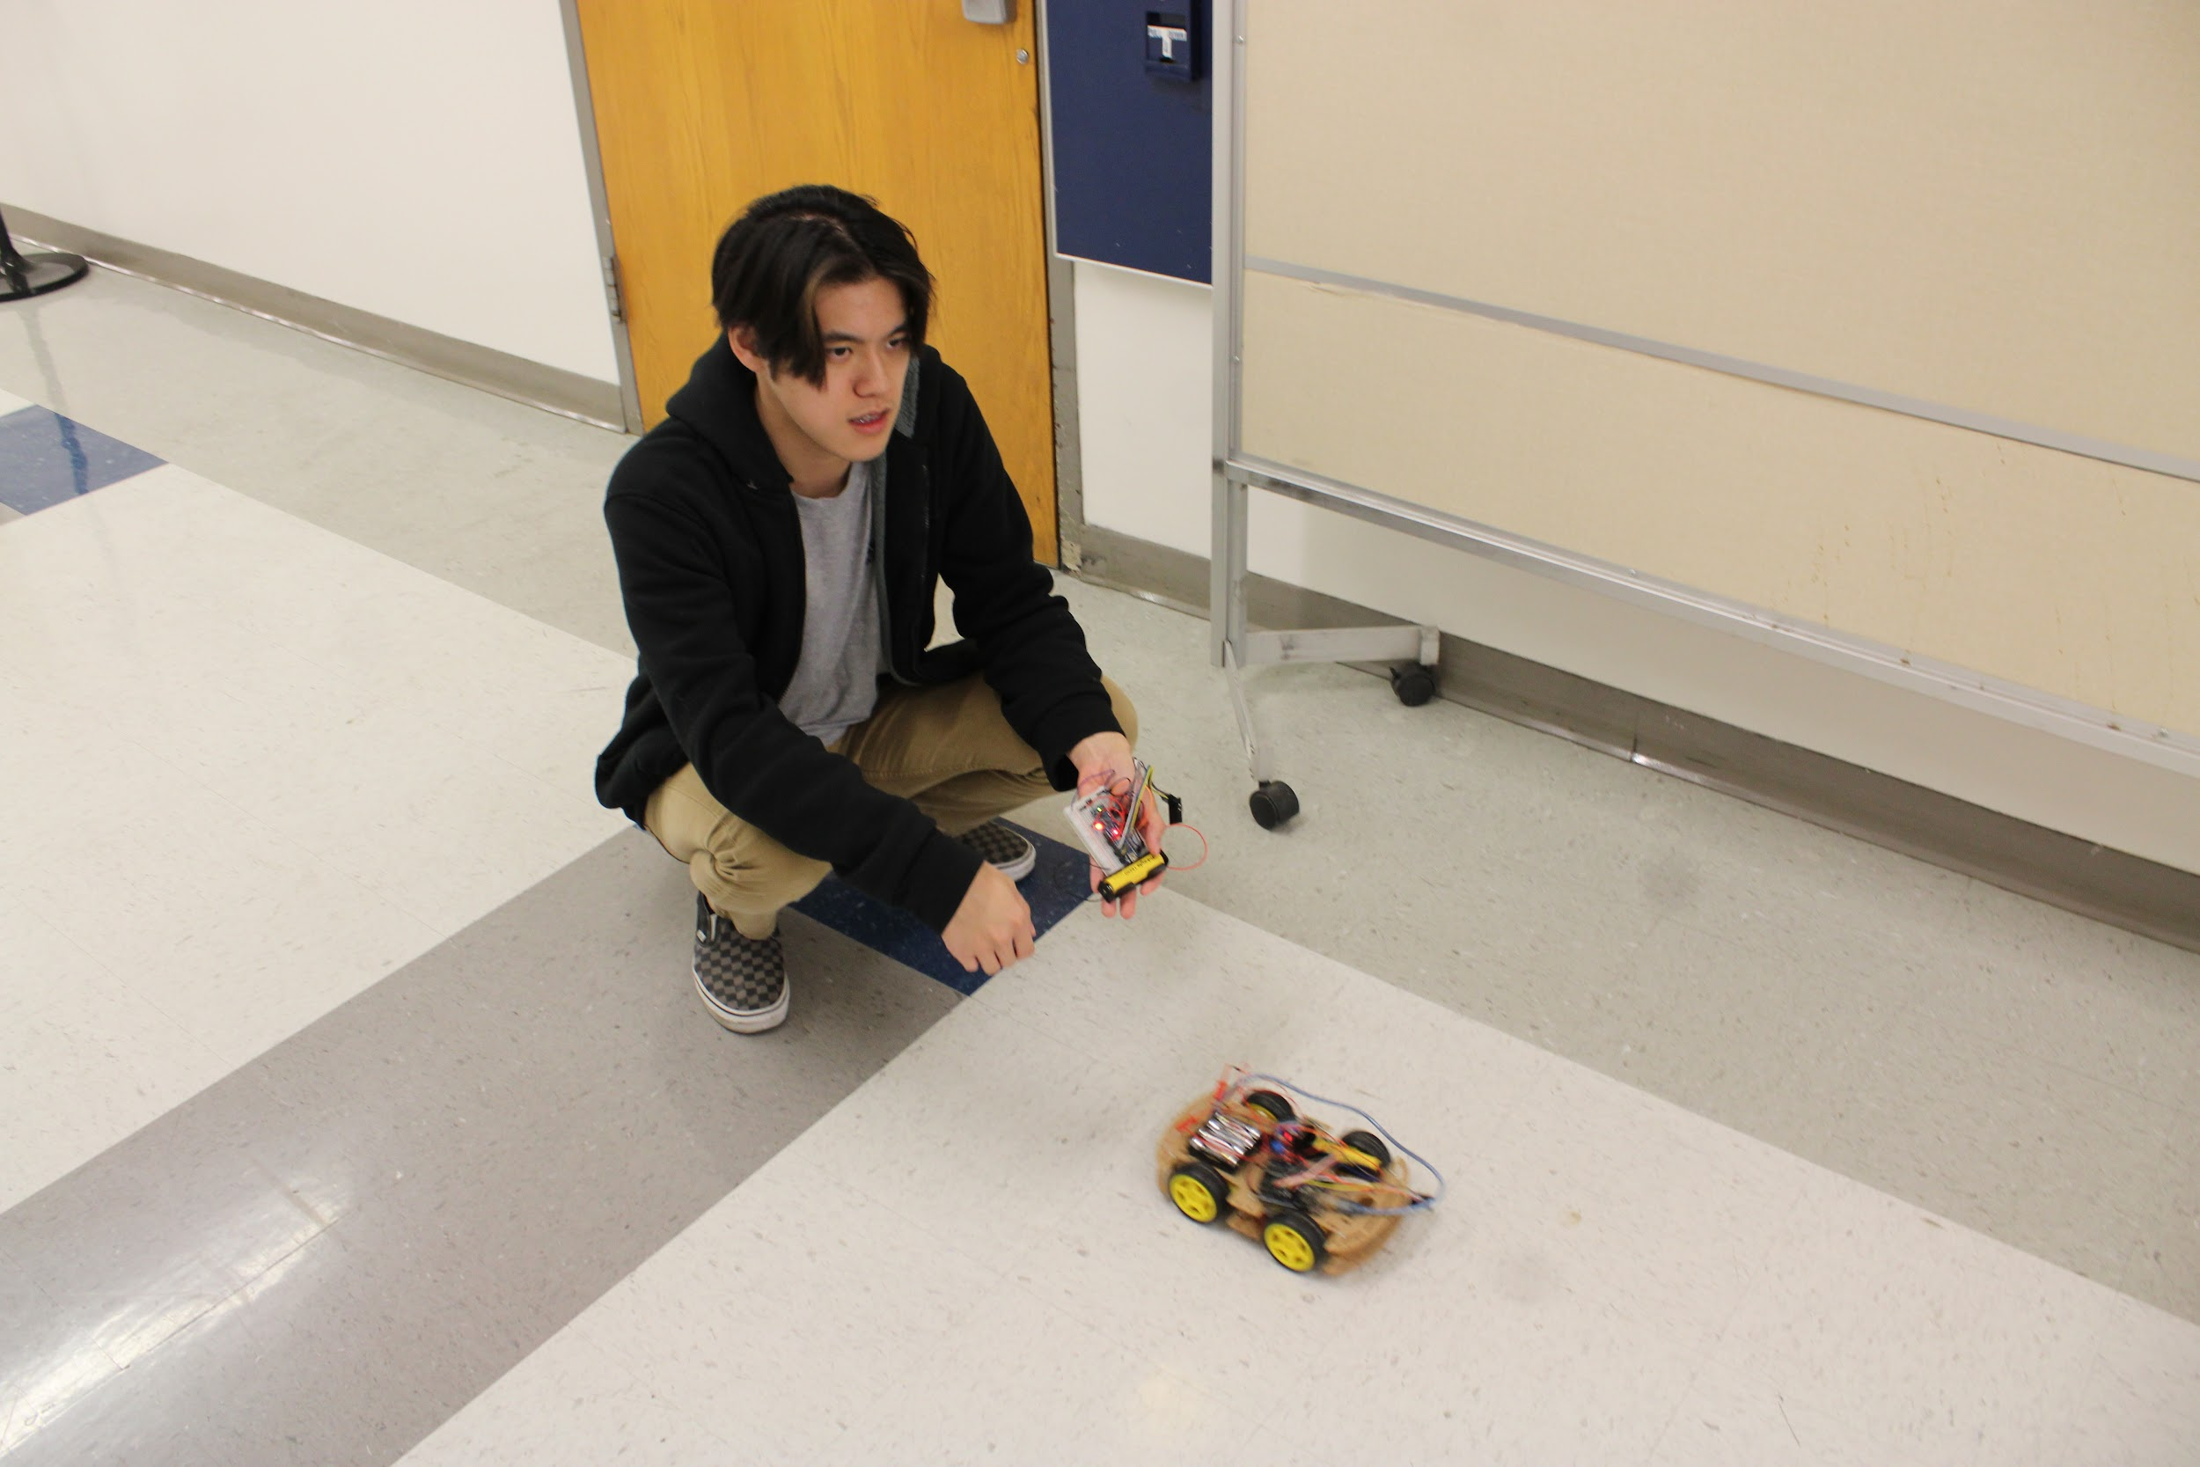
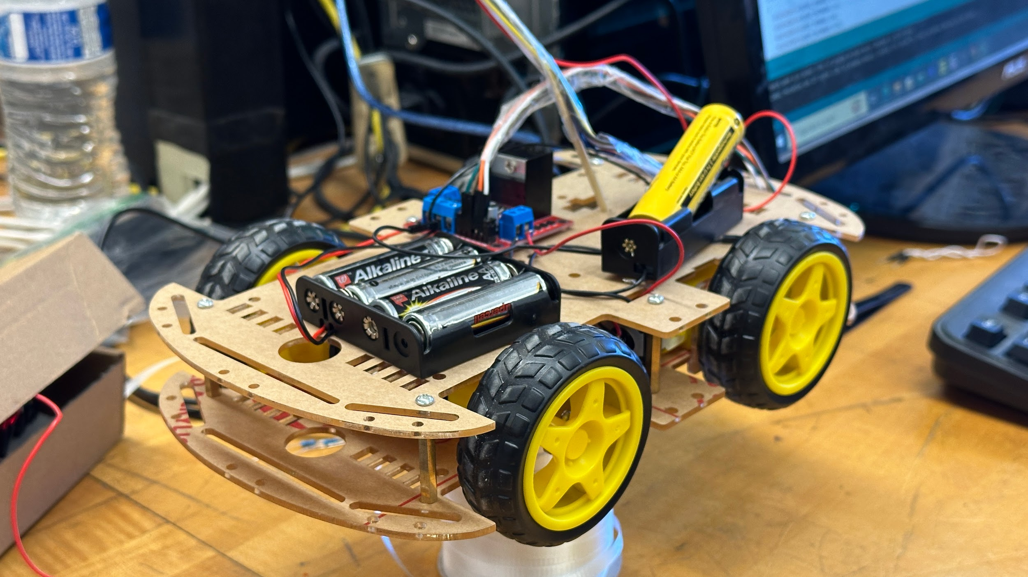
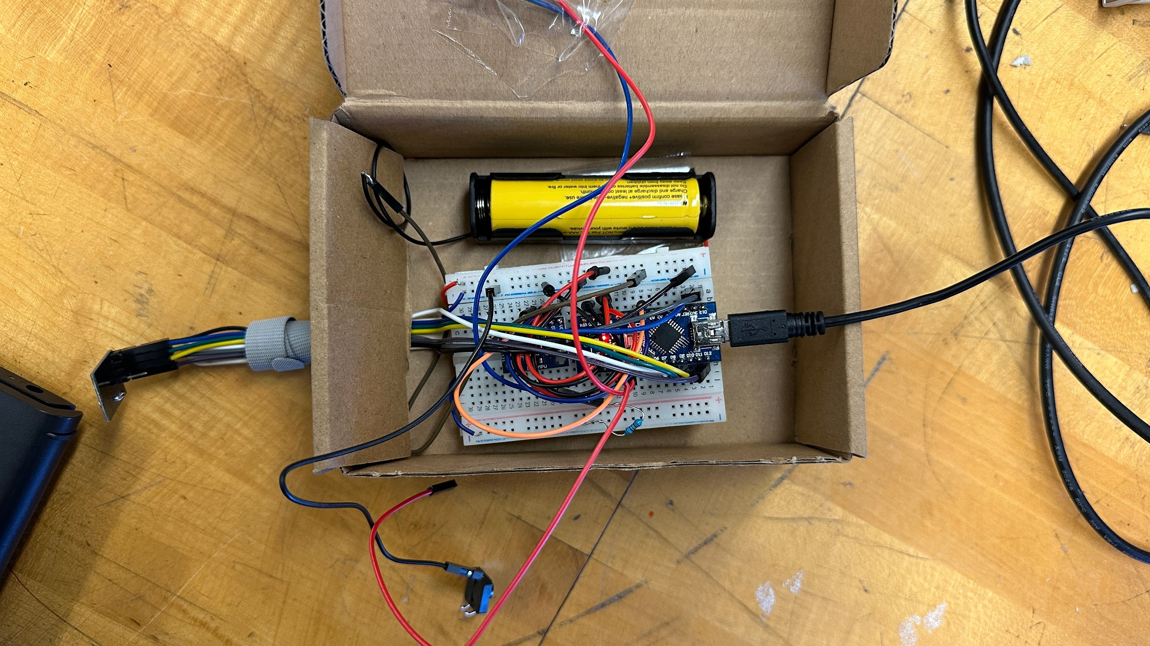
Semester Project Presentation
Cody Hum Alberto Rosas Dang Tran

Slide 2
DIY Hand Gestures Controlled Car
Using Arduino
What does it do? | Specifications
The car is controlled remotely through hand gestures. The transceiver transmits the acceleration of the motion and the coordinates based on its position in the XY axis. The receiver retrieves the data and the UNO R3 signals which motor on the car to drive. Hand rolls forward → car moves forward Hand rolls back → car moves in reverse Hand rolls left → car spins to the left Hand rolls right → car spins to the right | Arduino Uno R3 Arduino Mini Nano L298N Motor Driver MPU6050 Accelerometer nRF24L01 Transceiver Modules Ion lithium battery + AA batteries

Slide 3
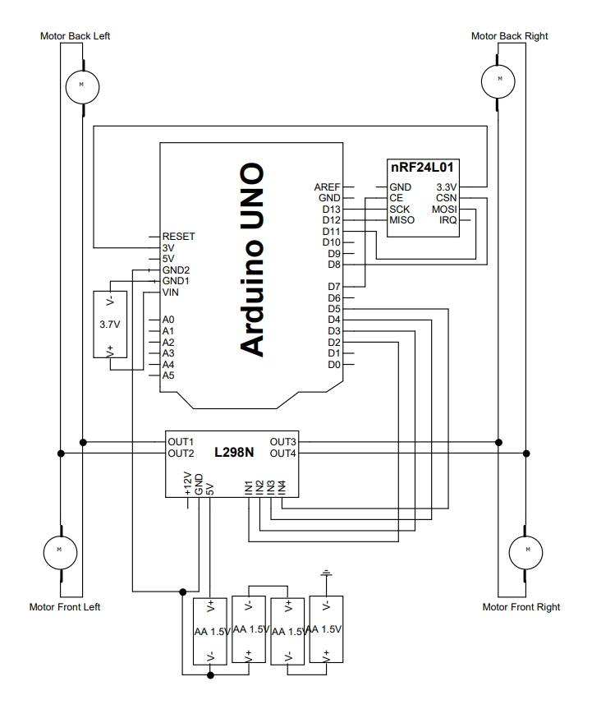
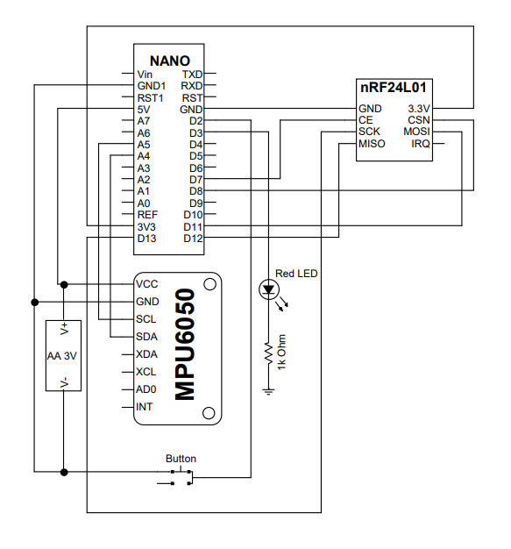
Block Diagrams
Receiver R_{X}
Transmitter T_{X}

Slide 4
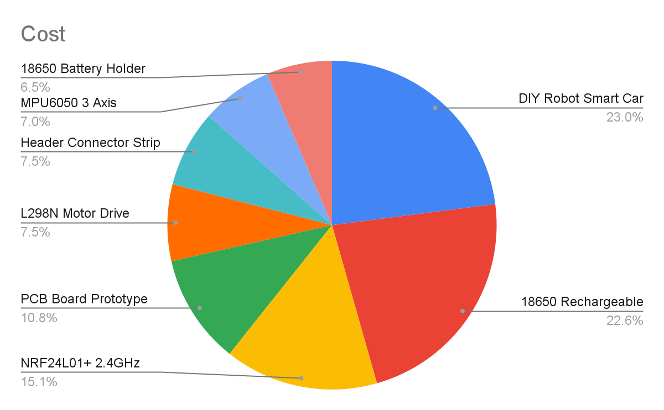
BOM (Bill of Materials)
Parts/Materials | Qty | Cost ($)
DIY Robot Smart Car Chassis | 1 | 21.29
1￵8￵6￵50 Rechargeable Battery | 1 | 20.99
NRF24L01+ 2.4GHz Wireless RF | 1 | 13.99
PCB Board Prototype | 1 | 9.99
L298N Motor Drive Controller Board | 1 | 6.99
Header Connector Strip 20mm | 1 | 6.99
MPU6050 3 Axis Accelerometer | 1 | 6.49
18650 Battery Holder | 1 | 5.99
UNO R3 Board ATmega328P | 1 | Free
Mini Nano V3.0 ATmega328P | 1 | Free
wires,button,led,1 resistor 1k |  | Free
AA battery | 4 | Free
Subtotal |  | 92.72
Tax |  | 9.272
Department Budget |  | -60
Total |  | 41.992
Cost per person |  | 14.00

Slide 5
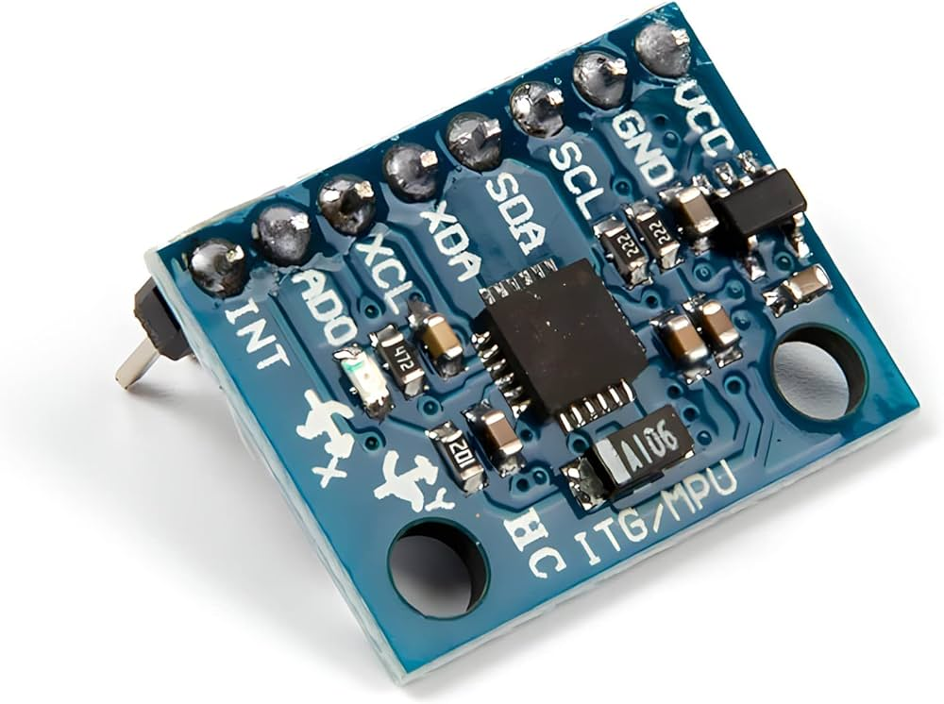

Learning Experience
Soldering
Complex wiring
Arduino/C++ programming
Testing the accelerometer

Slide 6

Challenges
Over budget cost (if any breaks, it could set us back by quite a lot)
How to use Arduino: aligning coordinates, transmitting data back & forth
Coding bugs: Doesn’t stop after radio stops transmitting
Car troubleshooting (i.e. fitting the wheels, not enough power feeding into the motors, electromagnetic interference)
$$$

Slide 7
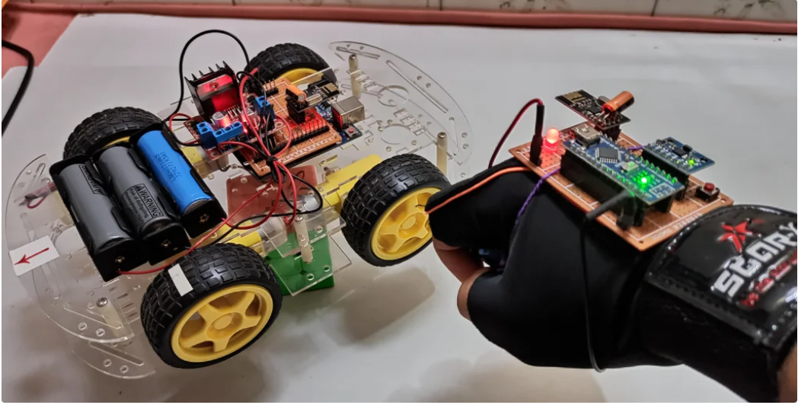
Improvements
Overall design/visual (better casing for chassis, cleaner housing for the wiring)
Faster speed (add more voltage)
Arduino/C++ code optimization
Wanted to fit the transceiver on a glove, ended up housing controller in a case
Add a powerswitch (ON/OFF)

Slide 8
LIVE DEMO

